Slide 1
A Formative Social Media Evaluation Framework
MyCarDoesWhat

Slide 2
GOALS
Develop a framework that can be used to evaluate the social media efforts of the MyCarDoesWhat campaign.
Begin to use this framework to help social media practioners on the MyCarDoesWhat project gain new insights into their work.

Slide 3
Evaluation
principles
The framework being developed is meant to provide recommendations on the direction of future content based on what has been done in the past.
To provide recommendations, the body of existing work was analyzed for patterns and themes in relation to performance metrics.

Slide 4
Presentation
organization
Prologue – Identifying social media goals
Methods – How the evaluation was conducted and framework developed
Category No. 1 – Text Formatting
Category No. 2 – Editorial Direction
Category No. 3 – Visuals and Content
Conclusions – Bringing It All Together and Discussion
> Goals of social media efforts are clarified.
> Body of work is evaluated on these dimensions.
> Recommendations for future content based off analysis.

Slide 5
Prologue. Framing the Purpose of Social Media in MyCarDoesWhat
Subhead of any value here?

Slide 6
Goals of social media
over time
IMPRESSIONS
REACH
ENGAGEMENT
As many impressions as possible
Quality traffic to content
Audience engagment
…Pre-Launch
Post-Launch…

Slide 7
Goal No. 1 Highest Possible Impressions
You want to achieve as many impressions as possible, regardless of the content of the posts.
Primary Evidence to Support Goal:
Post impression counts from Facebook Insights
Post impression counts from Twitter Analytics
Video metrics in YouTube Analytics
Impressions Defined: A member of public was exposed to a logo, message or campaign name

Slide 8
Goal No. 2 Quality Campaign Traffic
Drive people to the campaign (primarily the website) who will actually engage with the content in some manner.
Primary Evidence to Support Goal:
Behaviors on posts, such as reach, shares and virability
Various web analytics of user behaviors through social media referrals, such as…
Bounce rate
Pages per session
Time on page and per session
Quality of Traffic Defined: The degree to which the individuals accessing content intended to do so, or do so with adequate intent. We will discuss what metrics apply to this later.

Slide 9
Goal No. 3 Audience Engagement
You want to encourage discussions and sharing on social media – prompted and organically.
Primary Evidence to Support Goal:
Various post metrics on Facebook and Twitter, such as:
Likes/Favorites
Shares/Retweets
New page likes/New followers
Replies and comments
Overall penetration on social media (Crimson Hexagon)
Organic social media: Discussions of a topic, organization or brand that occur unprompted by an entity. For example: “@” in Twitter; mentions in Facebook.

Slide 10
Methods.
How the evaluation was conducted
Subhead of any value here?

Slide 11
Evidence and analysis tools
The following channels were evaluated…
MyCarDoesWhat official Facebook page
@MyCarDoesWhat official Twitter stream
MyCarDoesWhat YouTube Channel
…using these industry-standard analysis tools
Facebook Insights and Ad Manager (Facebook-owned tools)
Twitter Analytics (Twitter-owned tool)
YouTube Analytics

Slide 12
Facebook
Soft-launched in June, 2015.
Paid Facebook advertising began July 18, 2015.

Slide 13
Twitter
Soft-launched in June, 2015.
There is no paid Twitter advertisement.

Slide 14
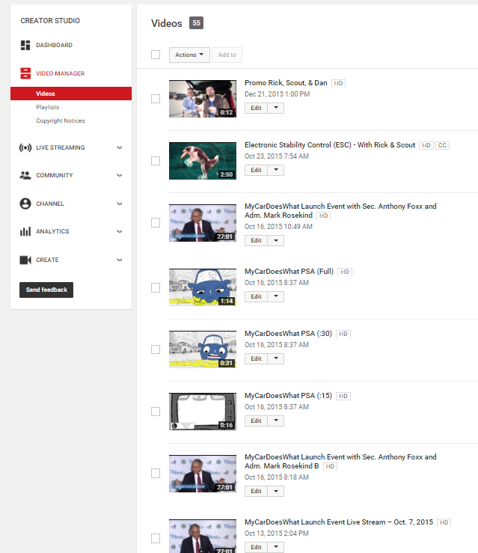
YouTube
Videos made public-facing in June 2015
Paid YouTube advertisement is handled exclusively by Qorvis MSLGROUP for the PSA – no other content used yet for YouTube advertisements.

Slide 15
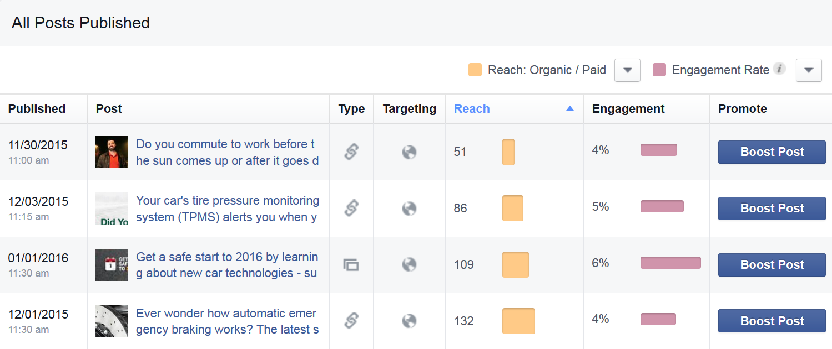
Analysis techniques: post list
Facebook Insights allows users to examine which posts have influenced reach and engagment.

Slide 16
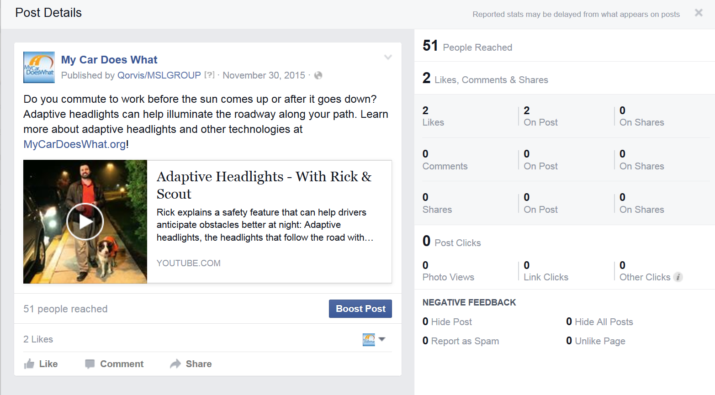
Analysis techniques: post details
Inside each post, users can examine various post factors that contributed to reach and engagment metrics
Notes:
Export this data to Excell, for linear regression analyses (due to both reach and engagement being continuous outcome variables) Exposure variables are analyzed as either continuous or categorical depending on the variable

Slide 17
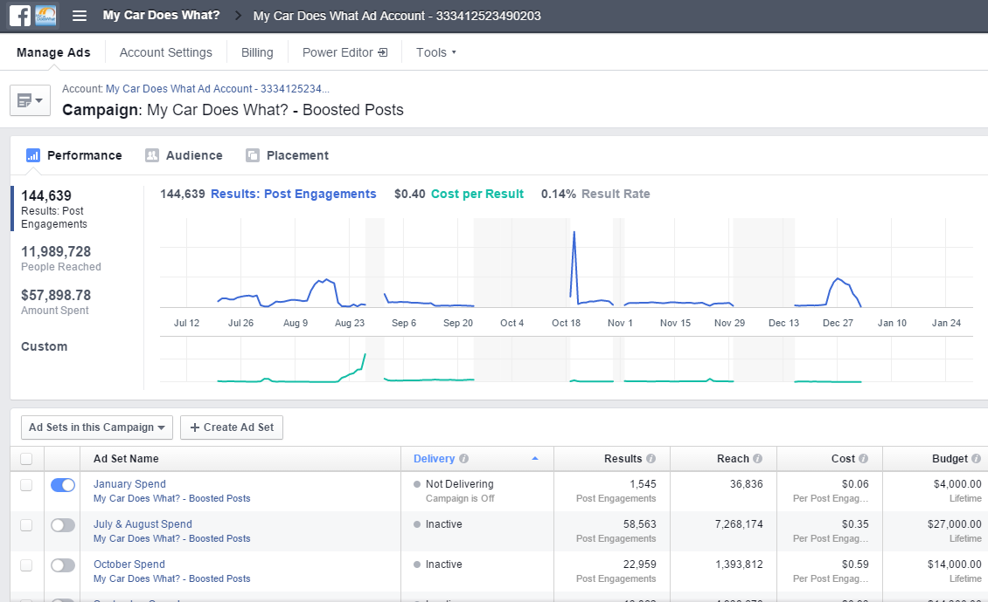
Analysis techniques: paid vs. non-paid
Paid social media advertising
Handled in Facebook Ad Manager, which includes more specific benchmarking tools
Excellent for evaluating impressions and conversions (i.e., website click-throughs)
Results can be best attributed to:
Content of posts
Pricing structure and posting strategies
Audience segmenations and targeting
Less so look and feel – formatting restrictions placed by Facebook
Paid social media posts will be evaluated separately from non-paid by NSC
Notes:
Export this data to Excell, for linear regression analyses (due to both reach and engagement being continuous outcome variables) Exposure variables are analyzed as either continuous or categorical depending on the variable

Slide 18
Analysis techniques: paid vs. non-paid
Non-paid social media posting
Handled in Facebook Insights, which excels at basic metrics and real-time troubleshooting
Excellent for evaluating post reach, engagement and real-time audience interactions
Results can be best attributed to:
Content of posts
“Extra” post content – links, audiovisuals, static images
Decisions on post look, feel, formatting and deployment
This framework will be based on non-paid social media activity
Notes:
Export this data to Excell, for linear regression analyses (due to both reach and engagement being continuous outcome variables) Exposure variables are analyzed as either continuous or categorical depending on the variable

Slide 19
Analysis techniques: Excel
Data 4 months of posts (8/18/2015 -12/22/2015) were documented in excel and qualitatively analyzed.
Data extracted 1/7/2015
Averages computed across categories and compared
Regression analyses and t-tests when possible
N=145

Slide 20
Analysis techniques: Excel
Using Facebook Insights and at N=145, there was sufficient data to begin developing a framework for evaluating Facebook non-paid social media content
Twitter Analytics provided less rigorous tools to evaluate posts than Facebook Insights; Facebook evaluation results can apply to Tweet content, audiovisuals, etc.
Waiting for further along in the campaign to use YouTube Analytics to evaluate YouTube strategies, if this would provide value

Slide 21
Category No. 1
Text Formatting
Subhead of any value here?

Slide 22
Definitions
Text Formatting

Slide 23
Copy length
Note: See Everybody Writes: Your Go-To Guide to Creating Ridiculously Good Content, by Ann Handley
Short
120 to 140 characters or fewer (Facebook, Twitter)
Medium
More than 140 characters (Facebook)
Notes:
Data highly correlated to line data (number of characters determines number of lines), therefore it is pointless to analyze. Especially when you consider it more likely that lines are what people immediately pick up on (look and see 2 lines or loooots of lines, vs knowing 150 characters or 800 characters).

Slide 24
Copy lines
Note: See Everybody Writes: Your Go-To Guide to Creating Ridiculously Good Content, by Ann Handley
Short
2 to 3 or fewer
Long
More than 3 lines
Notes:
Continuous data preferred over categorical

Slide 25
Copy links
In-Text
End of Post

Slide 26
“Read more”
Self-Contained
Expandable

Slide 27
FINDINGS
Text Formatting
Characters, Lines, Links, Read More

Slide 28
Preliminary Analyses indicated # of characters was highly correlated win # of lines r=.971
Insufficient sample size (n=1) to analyze
The amount of people reached decreases by about 11 posts per line of text added
Number of lines had no significant effect on reach or engagement

Slide 29
Overall, having any links in the post resulted in ~177 fewer people reached, and 0.02% lower engagement than posts with no links.
When links were present, external links were associated with highest average reach.
Posts having both internal and external links were associated with the highest engagement rate.

Slide 30
Links are positioned in-text, at the end of a post, or both (when more than one link is shared).
Posts that share links both in text and at the end of the post were associated with the highest reach.
Posts that only shared links in text were associated with the highest engagement rate.

Slide 31
RECOMMENDATIONS
Text Formatting
Based on the analysis of social media data to date, the following tactics are recommended based on your goal.

Slide 32
If your goal is content reach….
Text Formatting
1. Lines
Fewer may be better!
2. Link Presence
Overall, not having them is better!

Slide 33
If your goal is content reach….
Text Formatting
3. Link Type
External links are better!
4. Link Position
Place links in text AND at the end of the post!

Slide 34
If your goal is engagement….
Text Formatting
1. Lines
Fewer lines may be better!
2. Link Presence
Include them!

Slide 35
If your goal is engagment….
Text Formatting
3. Link Type
Having internal and external links in the post is best!
4. Link Position
Place link in text only!

Slide 36
Category No. 2
Editorial Direction
Subhead of any value here?

Slide 37
Definitions
Editorial Direction

Slide 38
Copy perspective
First Person
Second Person
Third Person

Slide 39
Content ownership
Note: See Social Media Metrics: How to Measure and Optimize Your Marketing Investment, by Jim Sterne
Owned
References only own site or materials
Third-Party
References news, world events and other sites

Slide 40
Point of View
Note: See Social Media Metrics: How to Measure and Optimize Your Marketing Investment, by Jim Sterne
Deliberate (Active)
Posts provide a viewpoint you can’t find elsewhere.
Neutrality (Passive)
Posts only provide objective data on a topic.

Slide 41
Familiarity of topic
Note: See Social Media Metrics: How to Measure and Optimize Your Marketing Investment, by Jim Sterne
Not Top 6
Car safety features is not in the campaign’s “Top Six” car safety features
Top 6
Car safety feature is in the campaign’s “Top Six” car safety features

Slide 42
Meta
Self-Referencing
Post clearly references the originator of the content.
External
Post presents ideas and topics divorced from originator.

Slide 43
FINDINGS
Editorial Direction

Slide 44
Posts worded in the third person perspective had highest reach and engagement rate. “Second Person” perspective had lowest reach and engagement rate.

Slide 45
Posts referencing third party owned materials or sites had significantly higher reach (p=.028).
Ownership of materials had no significant affect on engagement (p=.889).e
fReferences only own site or materierences only own site or materials

Slide 46
Point of view had no significant effect on reach or engagement.
only own site or materierences only own site or materials

Slide 47
Topic familiarity had no significant effect on reach or engagement.
only own site or materierences only own site or materials

Slide 48
Posts that referenced sites and materials from both internal and external references had the highest reach and engagement rate.
only own site or materierences only own site or materials

Slide 49
RECOMMENDATIONS
Editorial Direction
Based on the analysis of social media data to date, the following tactics are recommended based on your goal.

Slide 50
If your goal is content reach….
Editorial Direction
1. Perspective
Try to word posts in third person and avoid use of words like “you and your”).
2. Ownership
Collaborate with third parties and share their resources!

Slide 51
If your goal is content reach ….
Editorial Direction
3. Point of view
Try sharing deliberate (active) information that may not be as availble eslewhere (statistics, system specifications, etc).
4. Familiarity
Try sharing content that is more recognizable than novel.

Slide 52
If your goal is quality traffic….
Editorial Direction
5. Meta
Avoid referencing the creater of the content!

Slide 53
If your goal is engagement….
Editorial Direction
Perspective
Try to word posts in third person and avoid use of words like “you and your”).
2. Ownership
Try to share materials that are self-owned.

Slide 54
If your goal is engagment….
Editorial Direction
3. Point of View
Try sharing Neutral (passive) information that may be as availble eslewhere (avoid statistics, system specifications, etc).
4. Familiarity
Try sharing content that is more recognizable than novel.

Slide 55
If your goal is engagment….
Editorial Direction
5. Meta
Make sure to reference the originator of the content.

Slide 56
Category No. 3
Visuals and Content
Subhead of any value here?

Slide 57
Definitions & examples
Visuals and Content

Slide 58
Photorealism
Real-Life
Photos depict real-life
Illustration
Photos are clearly illustrated
Cartoon
Photos created using digital art tools

Slide 59
Photorealism
A. Real-Life

Slide 60
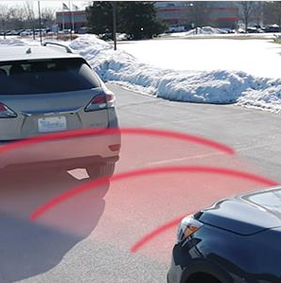
Photorealism
B. Illustration

Slide 61
Photorealism
C. Cartoon

Slide 62
Audiovisual
Static Visuals
Just images – they don’t move
Animation
A collection of images that move; usually involving CGI; usually short but can be long
Live-Action
Full-length live-action (real-life) video clips of a variety of styles; short to long

Slide 63
Audiovisual
A. Static Visuals

Slide 64
Audiovisual
B. Animation

Slide 65
Audiovisual
C. Videos

Slide 66
Landing destination
Owned Content
Post sends users to owned content or sites
External Content
Post sends users to external content or sites

Slide 67
Text-to-Graphics Ratio
Note: See info on official rule at https://www.facebook.com/business/help/468870969814641
Text-Dominant
Text has more real estate in post area than graphics
Balanced Text/Image
Text and graphic share similar real estate in post space
Graphics-Dominant
Graphics have more real estate in post area than text
Notes:
20% rule only applies to ads (boosted). Ran analysis as Low text ratio, balanced text ratio, heavy text ratio

Slide 68
Text-to-Graphics
C(1) Weighted text over graphic

Slide 69
Text-to-Graphics
B. Balanced Text to Image

Slide 70
Text-to-Graphics
C(2) Weighted graphic over text

Slide 71
Auto- Play
Turned On
Videos – with or without sound – will play upon scroll or hover
Turned Off
Visitor must active all videos manaully; or must active sound
Notes:
Could not analyze auto play n=0

Slide 72
Short-form moving visuals
Vine
Short actual video, 6 seconds or less, with sound; can be shared, not saved
GIF
Image file that “animates” a series of pictures. Can be shared or saved.
Notes:
Could not analyze short form vine n=0 gif n=0

Slide 73
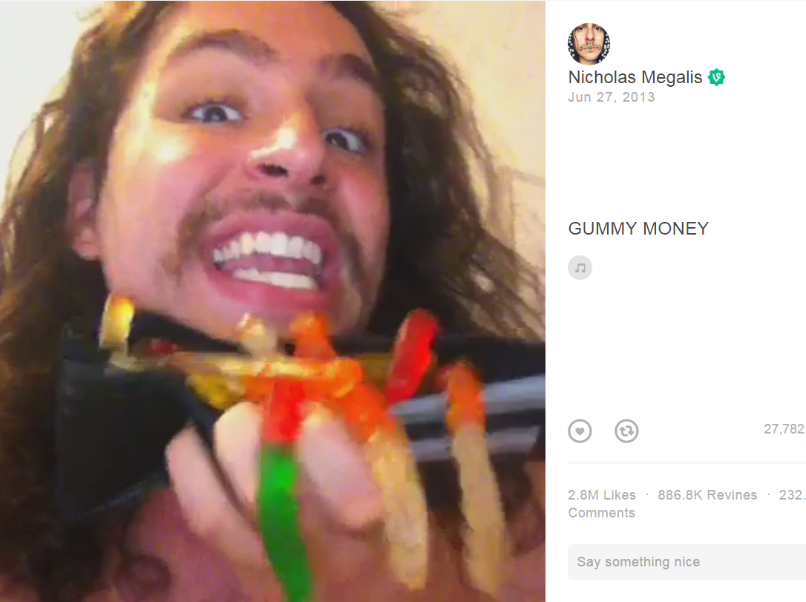
An Example of a Vine
“Gummy Money” by Nicolas Megalis is the most-looped Vine of all time (as of Nov. 2015).
Content link:
https://vine.co/v/hzxpjd6b9d9

Slide 74
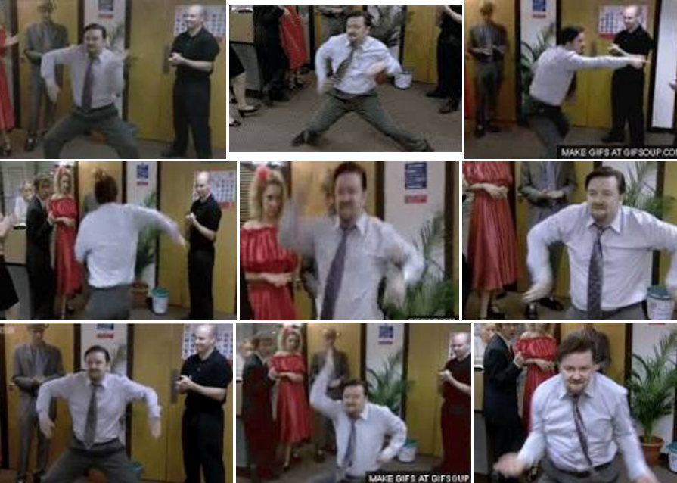
An Example of a GIF
“Ricky Gervais dance” from “The Office (UK)” is one of the most popular GIFs of the 2000s.
Content link:
https://vine.co/v/hzxpjd6b9d9

Slide 75
Safety Systems
Note: See info on official rule at https://www.facebook.com/business/help/468870969814641
None
Post makes no mention of any specific safety system or feature.
Single
Post references a single safety system or feature.
Multiple
System references multiple safety systems or features.

Slide 76
Mascot Visibility Scout
Present
Scout is clearly visible on the post
Absent
Scout is not visible on the post

Slide 77
FINDINGS
Visuals and Content

Slide 78
Posts that displayed real life images had the highest reach.
Posts that displayed Illustrated or CGI enhanced photos had the highest engagement rate.

Slide 79
Playable videos had significantly higher reach than static visuals (p=.02) but no significant difference on engagement rate.
Overall animations had the highest reach and engagement rate.
Notes:
When format duration was compared using linear regression we see a slight increase in reach and engagement rate as you increase the duration of the video but not normally distributed.

Slide 80
Landing destination had no significant effect on reach (p=0.133) or engagement rate (p=0.779).
Overall, posts that landed on externally owned content had higher reach.
Overall, posts that landed on internally owned content had higher engagement rates.

Slide 81
Overall, having a low text to graphic ratio had highest reach and engagement rate.

Slide 82
Mentioning multiple systems had the highest reach, while not mentioning any systems had the highest engagement rate.

Slide 83
Mascot visibility had no significant effect on reach (p=0.40), or engagement rate (p=0.56).

Slide 84
RECOMMENDATIONS
Visuals and Content
Based on the analysis of social media data to date, the following tactics are recommended based on your goal.

Slide 85
If your goal is content reach ….
Visuals and Content
1. Photorealism
Try using real-life images when posting a photo or splash screen.
2. Audiovisual Format
Share playable videos rather than static photos (especially short clips)!

Slide 86
If your goal is quality traffic….
Visuals and Content
3. Landing
Try linking to externally owned content.
4. Text to Graphics Ratio
Use less text, more graphics!

Slide 87
If your goal is content reach ….
Visuals and Content
5. Safety Systems
Try mentioning multiple systems in the post.
6. Mascot Visibility
Try having the mascot visible on the post.

Slide 88
If your goal is engagement….
Visuals and Content
1. Photorealism
Try using Illustrations or CGI enhanced images when posting a photo or splash screen.
2. Audiovisual Format
Try sharing playable videos rather than static images (especially short clips).

Slide 89
If your goal is engagment….
Visuals and Content
3. Landing
Try linking to internally owned content.
4. Text to Graphics Ratio
Try using less text, more graphics!

Slide 90
If your goal is engagment….
Visuals and Content
5. Safety Systems
Try not to mention any specific systems. Stay general.
6. Mascot Visibility
Try excluding the mascot from the post.

Slide 91
Conclusions.
Bringing it all together
Subhead of any value here?

Slide 92
1. Share Ownership
2. Meta Reference
3. Audio-Visual Selection
Share materials and websites that are owned by third-party sources to significantly increase reach.
If deciding between self-referencing OR referencing external sources, share external for significantly higher engagement rate
Share playable videos and animations rather than static images to significantly increase reach.

Slide 93
The limitations
1. Small Sample
Several categories could not be analyzed due to the small sample of posts that fell into that category or a control group (i.e. see more, targeting, vines)
2. Analyses
Due to small sample size, multivariate analyses could not be conducted. Univariate regressions and t-tests were conducted when sample size permitted. Analyses were primarily qualitative.
3. Replicability
Insights captures data in real time and requires manual exportation. Therefore reach count and engagement rates cannot be validated after the point of export.

Slide 94
Next steps
Once framework is close to being finalized, schedule it to be deployed on a regular basis throughout life of campaign.
Use framework to help evaluate the success rate of new strategies deployed based on recommendations.
Expand framework to include Twitter Analytics data and YouTube Analytics once there is sufficient data to use and there is any interest.

Slide 95
Sources used in
presentation
Facebook Insights (certified in-house Facebook evaluation tool)
MyCarDoesWhat.org (video screen shots)
Vine example source
GIF example source

